Slide 1
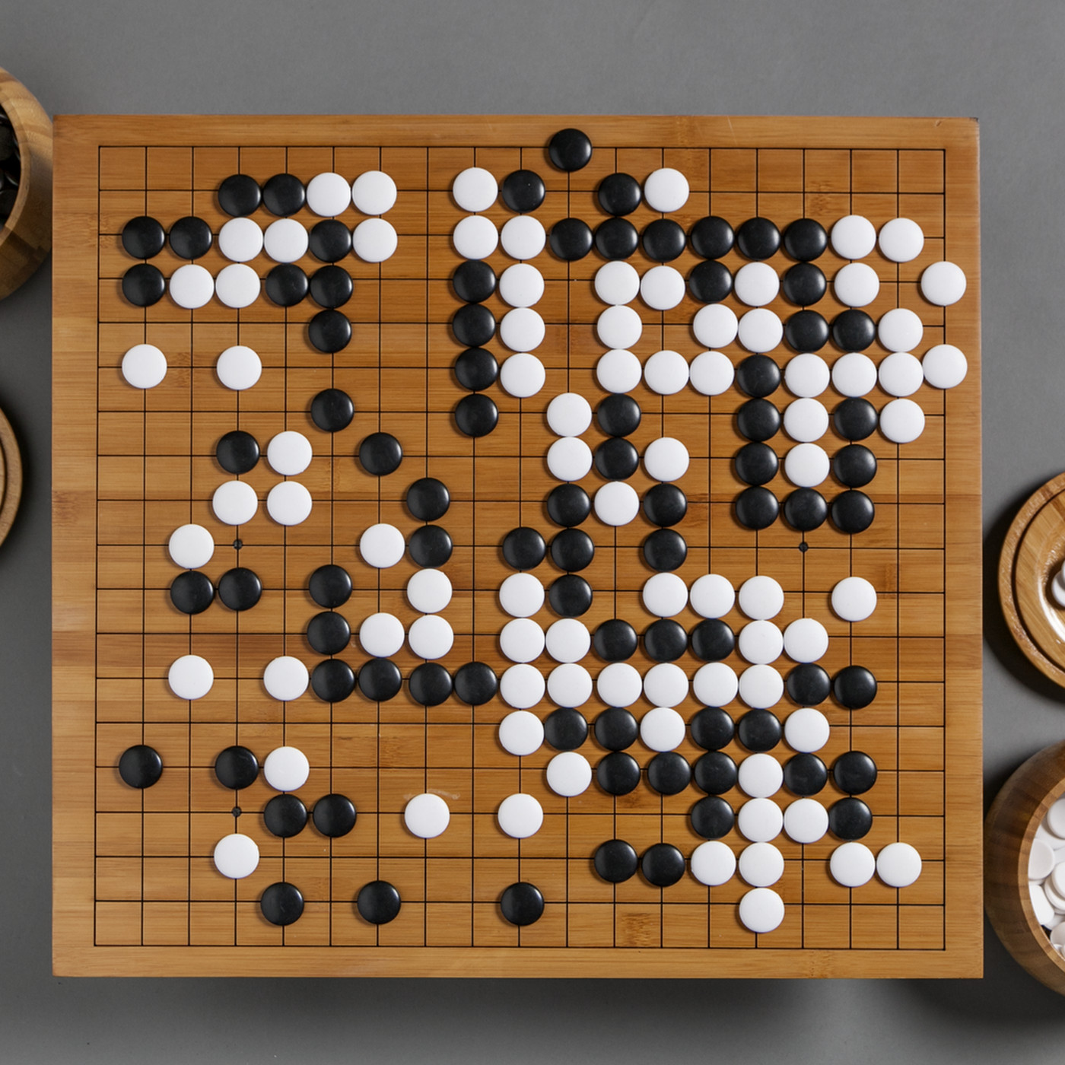
CSCI 599: ZeroGo
Solving the game of Go with ML
Mid-term presentation
Sunny Patel
Jing Ouyang
Wesam Alwehaibi

Slide 2
What is Go?
Invented in China 2500 years ago, is the oldest board game played today
2 players with the goal of surrounding opponent’s chess with their own
Rules:
Liberty Rule: Every stone must have a Liberty(open point) or belong to a group that has a liberty
KO rule: Stones do not repeat their positions

Slide 3

Why ZeroGo is interesting?
Google acquired DeepMind at $500M which built AlphaGo that beat Lee Sedol
“AlphaGo is the first computer program to defeat a professional human Go player, the first to defeat a Go world champion, and is arguably the strongest Go player in history”
Alphago Requirements:
Needs 4+ TPUs or 200+ GPUs
Needed 5+ years to complete!
500 times the depth of the game tree of Chess
130,000 “possible next moves” after first 2 turns (Chess has 400)

Slide 4
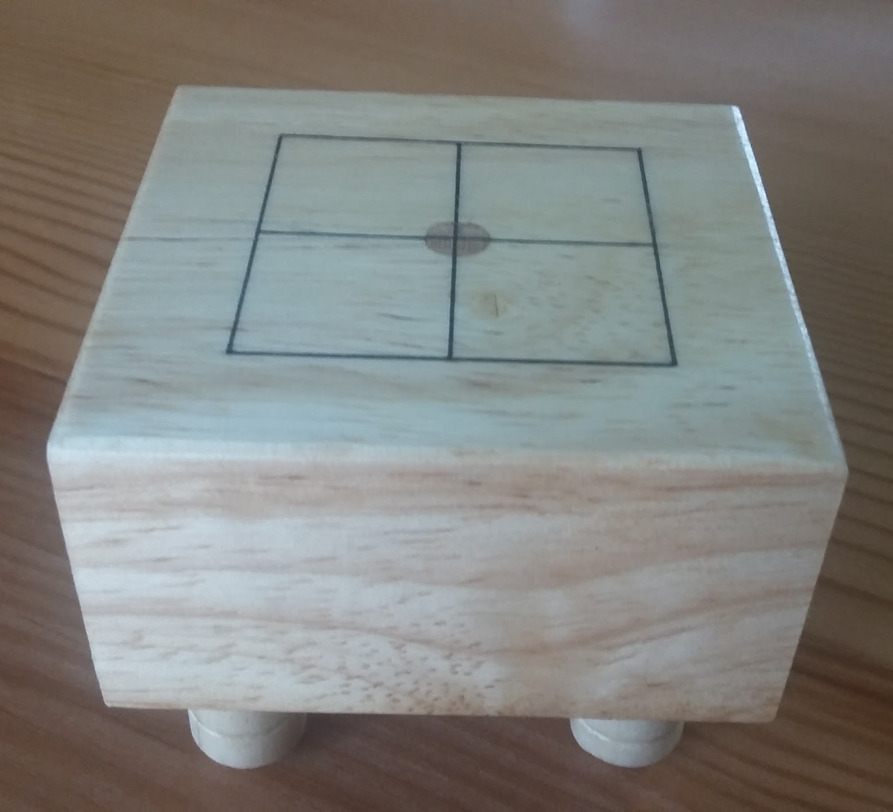
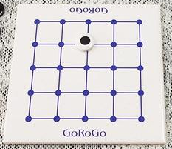
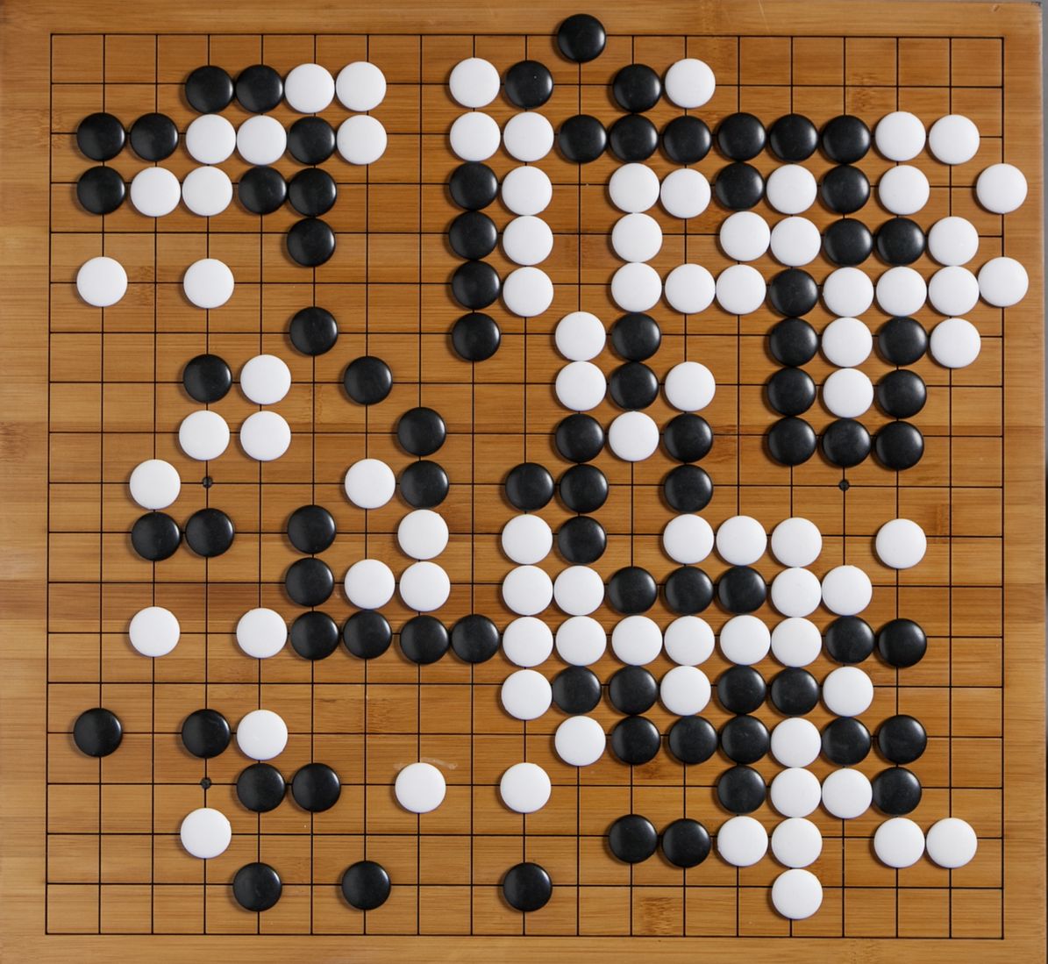
Why ZeroGo is interesting?
3x3 Board
12000 valid states
5x5 Board
414,295,148,741 valid states
19x19 Board
2.08168199382 x 10¹⁷⁰!!! valid states

Slide 5
Current Progress

Slide 6

Current Progress
Currently Developed Agents
Random
Greedy
Search Based
ML Based
Minimax
Depth Pruned
Alpha beta
MCTS
Neural Network
Actor Critic

Slide 7
Current Progress
Currently Developed Agents
Helps Other agents Learn and explore
Fast for any board size
Random
Greedy
Search Based
ML Based
Minimax
Depth Pruned
Alpha beta
MCTS
Neural Network
Actor Critic

Slide 8
Current Progress
Currently Developed Agents
Fast for any board size
Slightly better than random agent and beginner human players
Random
Greedy
Search Based
ML Based
Minimax
Depth Pruned
Alpha beta
MCTS
Neural Network
Actor Critic

Slide 9
Current Progress
Currently Developed Agents
Checks game tree to the end
Huge branching factor
Random
Greedy
Search Based
ML Based
Minimax
Depth Pruned
Alpha beta
MCTS
Neural Network
Actor Critic

Slide 10
Current Progress
Currently Developed Agents
Depth of 1-- fast
Depth of 2-- very slow
Fails for depth more than 1 in boards larger than 5x5
Random
Greedy
Search Based
ML Based
Minimax
Depth Pruned
Alpha beta
MCTS
Neural Network
Actor Critic

Slide 11
Current Progress
Currently Developed Agents
Difficult to predict the winner
Not a smart agent
Random
Greedy
Search Based
ML Based
Minimax
Depth Pruned
Alpha beta
MCTS
Neural Network
Actor Critic

Slide 12
Current Progress
Currently Developed Agents
Performs better than alpha beta and depth pruned agents
Performance is not adequate for a regular board (19x19)
Random
Greedy
Search Based
ML Based
Minimax
Depth Pruned
Alpha beta
MCTS
Neural Network
Actor Critic

Slide 13
Current Progress
X: board state; y: predicted move
Achieved roughly 27% accuracy
Trained on 5000 historical game plays of 19x19
Shows adequate game play and its level is roughly 15 kyu (Casual Player Level)
30kyu 20kyu 10kyu 1dan 6dan 9dan
Currently Developed Agents
Random
Greedy
Search Based
ML Based
Level of current Agent
Minimax
Depth Pruned
Alpha beta
MCTS
Neural Network
Actor Critic

Slide 14
Current Progress
RL algorithm
Agent trained using 15000 self-play games of 5x5 board
Agent is compared to its previous versions
Needs to be trained on a lot more self play games to show adequate game play
Currently Developed Agents
Random
Greedy
Search Based
ML Based
Minimax
Depth Pruned
Alpha beta
MCTS
Neural Network
Actor Critic

Slide 15
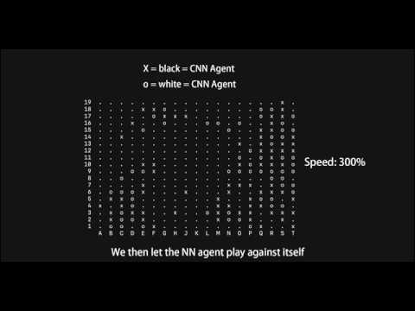
Demo

Slide 16
Post-midterm plans

Slide 17
Reminder - Goals from proposal
Goal 1: Answer “how far can we go with a normal hardware or $500M?”
A smaller board size? - 5X5 works! 7X7 works! 19X19 is WIP!
Real board with lesser win %? - Around 30% (40% is the highest claimed accuracy without sophisticated hardware)
Goal 2: Devise smarter algorithms
Can’t run Q-Learning with 10¹⁷⁰ states.
Deep Q-Learning? Deep Neural Networks? MCTS? - WIP, planning to use combination of algorithms, trained different architectures
Goal 3: Build less sophisticated players/other online players to benchmark
Greedy heuristics? - WIP
Interview players to see what strategies they use? - Used real games for training
Notes:
Best way to judge progress - to check how we are doing with the goals
Goal 1: work without using hardware - 5X5, 7X7 - unbeatable - we have 30% for full board and 40% is highest claimed accuracy outside of alpha go family
Goal 2: better alogirhtms - we used deep q learning, convolutional NN, combination of reinforcement learning and NN to improve NN performance
Goal 3: Benchmarking - we have less efficient algorithms to play against - we used real games from championships to train the model which means we have good strategies in there

Slide 18
Next 3 weeks - More implementation
Train the existing agents with more data
Add more heuristics
Implement newer algorithms and combinations
Work on
Actor Critic Agent - Value networks and Policy network
Reinforcement Learning to improve the Neural agent
Neural Network tuning
Neural network with MCTS
Notes:
Looking ahead, for the next 3 weeks -
we plan to implement more things
-add more algorithms and train current models more.
Work on actor critic and alphago and ZEROGO impl

Slide 19

Next 3 weeks
Currently Developed Agents
Random
Search Based
ML Based
Minimax
Depth Pruned
Alpha beta
MCTS
Neural Network
Actor Critic
Value Network
Policy Network
Game Heuristics
More sophisticated agent

Slide 20
2 Weeks after that - Converging our ideas
Come up with statistics
Establish numbers and limits for:
Board size
Performance criteria
Win %
Answer all the questions that are in the goals and start working on the demo and presentation.
Notes:
2 weeks after, we plan to start establishing the numbers - size, limits, accuracy etc

Slide 21
Thanks!

